Slide 1
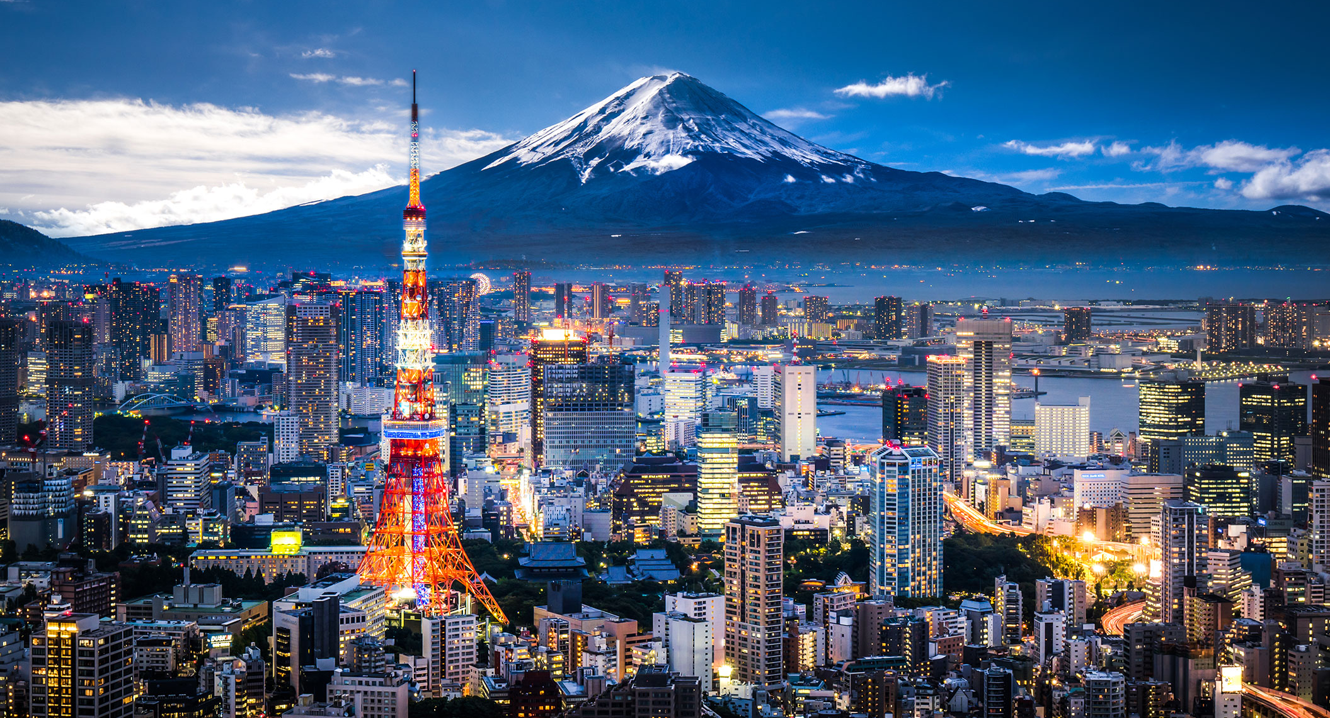
JAPAN
Japan is an island nation located in East Asia. It is known for its distinct culture, advanced technology, and historical significance. Below is a systematic breakdown of Japan's location and area:
Continent: Asia (East Asia)
Coordinates: Approximately 35.68° N latitude and 139.76° E longitude
Region: Japan is part of the Asia-Pacific region, located off the eastern coast of the Asian continent.

Slide 2
JAPAN
Japan is an island nation located in East Asia. It is known for its distinct culture, advanced technology, and historical significance. Below is a systematic breakdown of Japan's location and area:
Continent: Asia (East Asia)
Coordinates: Approximately 35.68° N latitude and 139.76° E longitude
Region: Japan is part of the Asia-Pacific region, located off the eastern coast of the Asian continent.

Slide 3

TOKYO TOWER
LOCATION: TOKYO
HEIGHT: 333 Meter (1,092) feet
COMPLETED: 1958

Slide 4
MOUNT FUJI (富士山, Fujisan)
LOCATION: Mount Fuji is located on the border between Shizuoka Prefecture and Yamanashi Prefecture in central Japan.
HEIGHT: 3,776 meters (12,389 feet)

Slide 5
JAPAN
Japan is an island nation located in East Asia. It is known for its distinct culture, advanced technology, and historical significance. Below is a systematic breakdown of Japan's location and area:
Continent: Asia (East Asia)
Coordinates: Approximately 35.68° N latitude and 139.76° E longitude
Region: Japan is part of the Asia-Pacific region, located off the eastern coast of the Asian continent.

